Slide 1
ENERGY
CFU 1
In your own words, what is energy?
Energy is the ability to do work
In Science, ‘work’ means making something happen eg. Move, heat, or cool etc.

Slide 2
ENERGY TRANSFORMATIONS

Slide 3
LEARNING INTENTIONS
CFU 1
What are we learning today?
I can identify energy transformations in various situations
I can represent energy transformations using diagrams

Slide 4
THE LAW OF CONSERVATION OF ENERGY
Vocabulary
Energy – The ability to do work
States that…
Energy cannot be created or destroyed, but it can be changed from one form to another.

Slide 5
FORMS OF ENERGY
Vocabulary
Energy – The ability to do work
Potential – stored energy that, when released, is converted to other forms such as kinetic, heat or light energy | Other
Gravitational Potential | Kinetic
Elastic potential | Heat
Chemical potential | Light
Nuclear potential | Sound
Electrical potential

Slide 6
ENERGY TRANSFORMATIONS
Vocabulary
Energy – The ability to do work

Slide 22
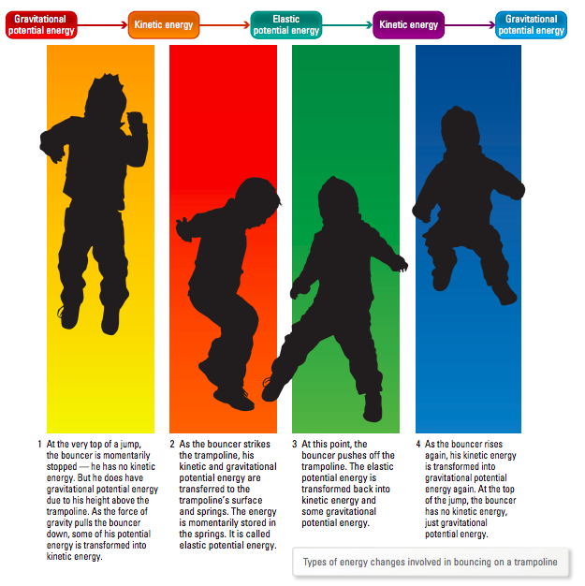

Slide 24
Kinetic
Nuclear
Heat
Light
Chemical
Electrical
A. Fire | B. Photosynthesis | C. Battery | D. Steam engine
E. Friction | F. Burning coal | G. Lightning | H. Battery charger
I. Toaster element | J. Sun | K. Torch | L. Solar panel
M. Moving muscles | N. Motor

